Slide 1
What is Science?
Dirk Riehle, Univ. Erlangen
NYT B01
Licensed under CC BY 4.0 International

Slide 2
Agenda
What is science?
Theory building and validation
Science as a social system
Programs and projects
Science and society
Research ethics

Slide 3
1. What is Science?

Slide 4
Definition of Science (Working Definition, Recap)
Science is the process of acquiring knowledge for correct prediction and reliable outcome. [DR]

Slide 5
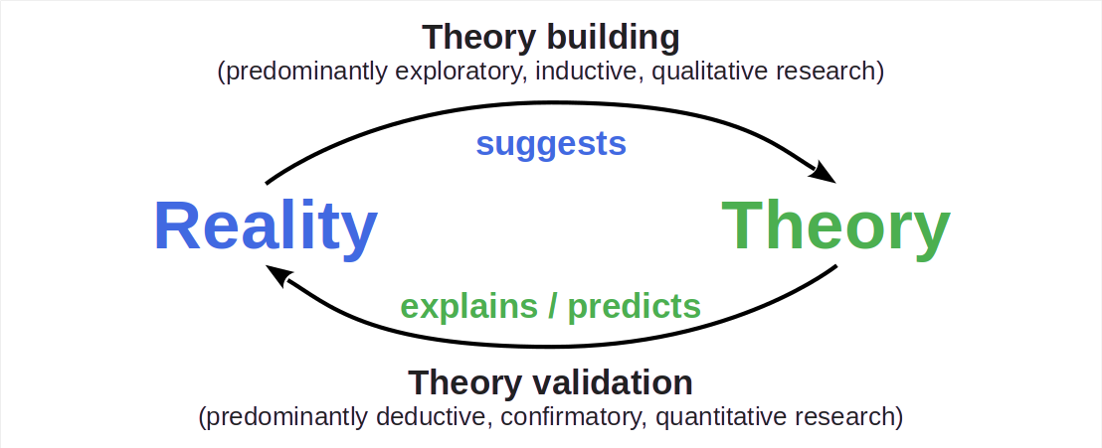
The Logic and Process of Science

Slide 6
Epistemological Stances
Objectivism (truth is independent of the observer and can be known)
Positivism / empiricism (truth can be determined and verified through observation)
Rationalism (some truths don’t follow from observation but rather logical thought)
Constructivism (truth depends on the observer and is socially negotiated)

Slide 7
Theory and Reality
A scientific theory is a model / framework / equation / …
That can be used to create hypotheses
A scientific hypothesis is a
Testable true/false statement about reality
In the smallest case, a (generalized) hypothesis is a theory

Slide 8
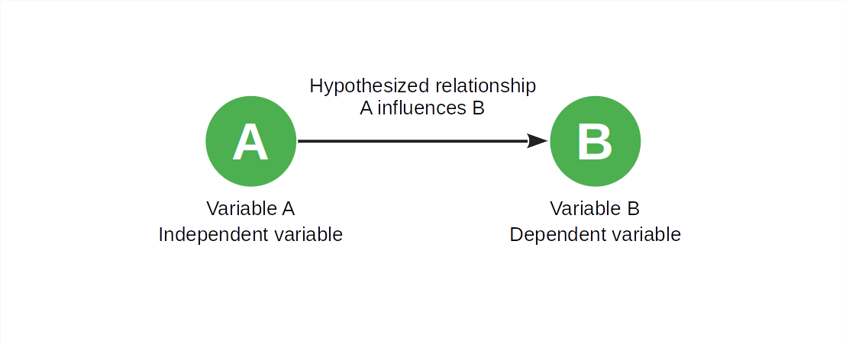
The Minimal Theory

Slide 9
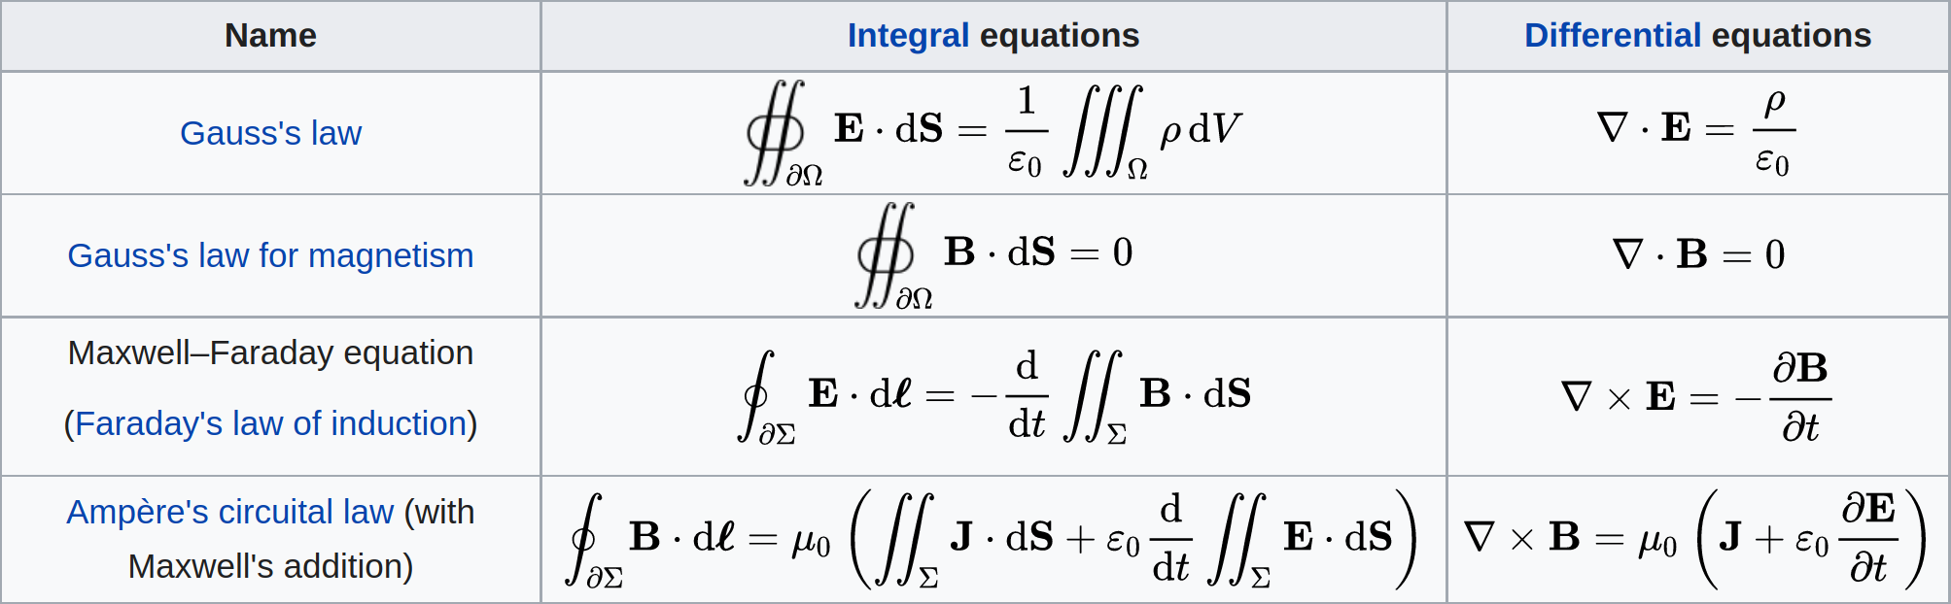
Maxwell’s Equations [1] of (Classic) Electromagnetism
[1] See https://en.wikipedia.org/wiki/Maxwell%27s_equations

Slide 10
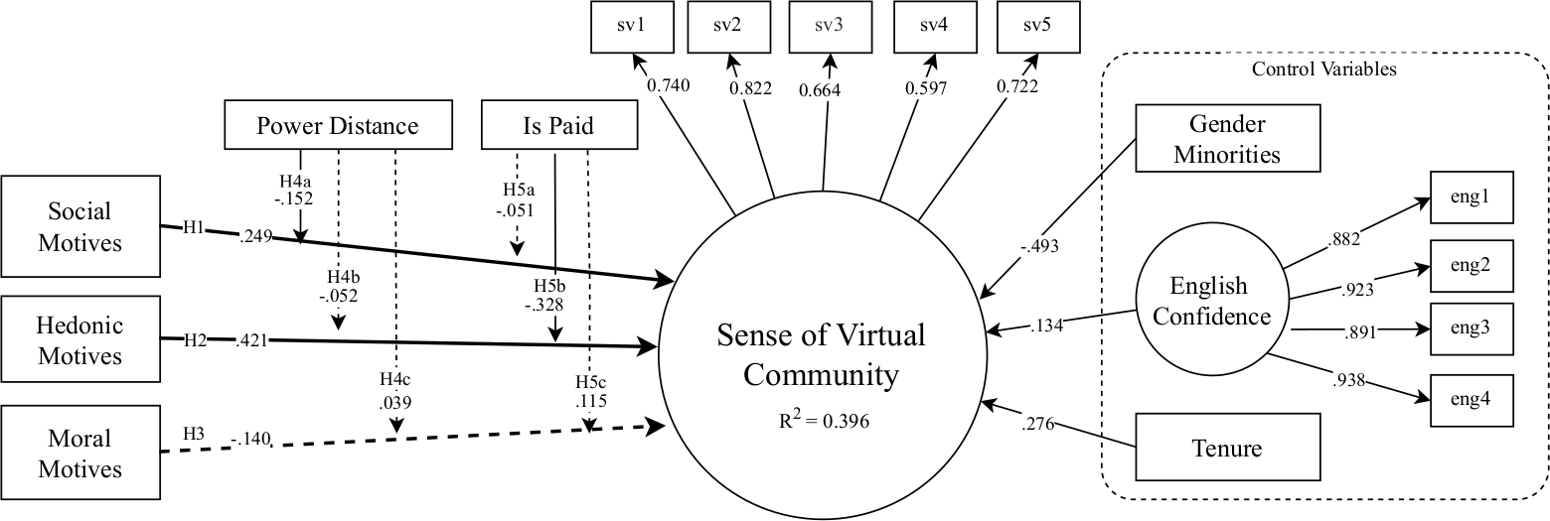
Structural Equation Model of Sense of Virtual Community [1]
H1: Social motives → SVC
H2: Hedonistic motives → SVC
H3: Moral motives → SVC
H4abc: Power distance x (H1, H2, H3 → SVC)
H5abc: Is paid for work x (H1, H2, H3 → SVC)
[1] See Trinkenreich et al. (2023): Do I belong?

Slide 11
Classification of Sciences (by Subject)
Formal Sciences
Mathematics, …
Natural Sciences
Physics, chemistry, biology, …
Social Sciences
Psychology, sociology, political science, …
Applied Sciences
Mechanical engineering, computer science, information systems, ...
Takes a formal approach
Takes an empirical approach
More likely to take an analytical approach
More likely to take a design science approach

Slide 12
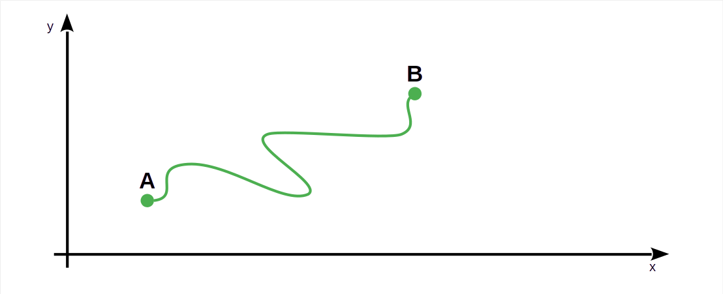
Solving a Problem vs. Building a Theory

Slide 13
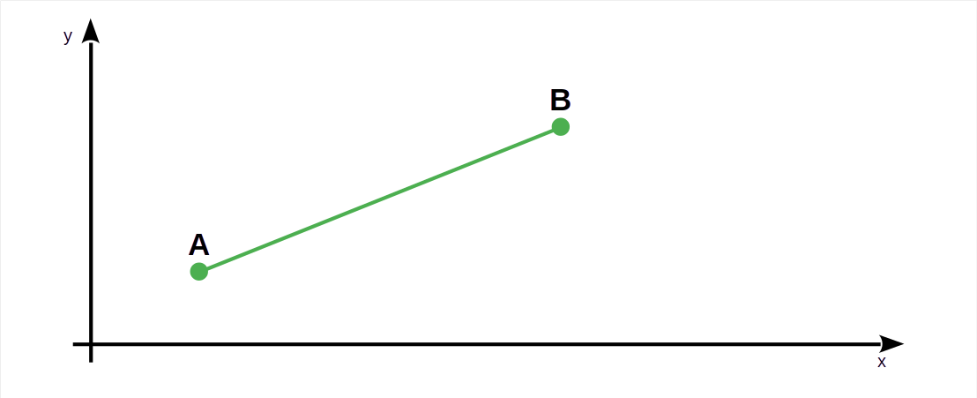
Using a Theory to Solve a Problem

Slide 14
Science vs. Engineering [1]
Science is
as defined before (“build to learn”, design science research)
Engineering is
The application of scientific principles (“learn to build”)
[1] Derived from Brooks, (1996): The computer scientist as toolsmith II.

Slide 15
2. Theory Building and Validation

Slide 16
Theory Building and Validation
Theory building is
The process of creating and revising (building out) a theory
Initial creation
Subsequent evaluation
Continued revision and evaluation
Theory validation is
The process of validating a theory by testing its hypotheses

Slide 17
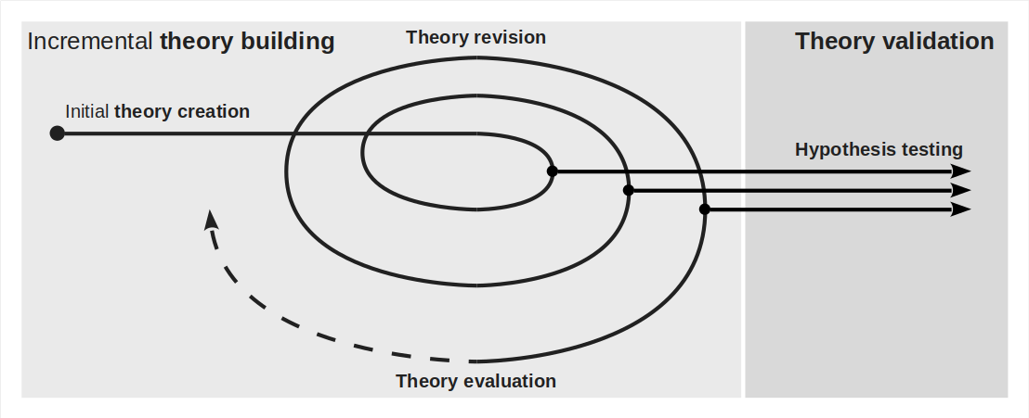
Interaction of Theory Building and Validation [1]
[1] Not drawn to scale or effort involved

Slide 18
Theory Evaluation vs. Validation [DR]
Theory evaluation is
The assessment of a theory for the purposes of revising it
Theory validation is
The testing of hypotheses to confirm or refute a theory
Many researchers (sloppily) use these terms interchangeably

Slide 19
Exploratory and Confirmatory Research
Exploratory research is
Theory building research
Confirmatory research is
Theory validation research

Slide 20
Inductive vs. Deductive Research
Inductive research is
Research that finds patterns in data to derive a theory
Deductive research is
Research that creates and tests hypotheses from theory

Slide 21
Qualitative vs. Quantitative Research
Qualitative research is
Research that works with qualitative data which is
Data collected for characterization using qualitative insight
Not easily measured and counted
Quantitative research is
Research that works with quantitative data which is
Data collected for generalization through statistical analysis
Numerical in some way

Slide 22
Terminology Alignment
Theory building | Theory validation
Exploratory | Confirmatory
Inductive | Deductive
Qualitative | Quantitative

Slide 23
Process of Theory Building and Validation
The process is almost always incremental and iterative
In science, there are at least three major scopes of iterations
While building out a single theory on a subject
While building out a paradigm through interrelated theories
While replacing an old paradigm with a new one

Slide 24
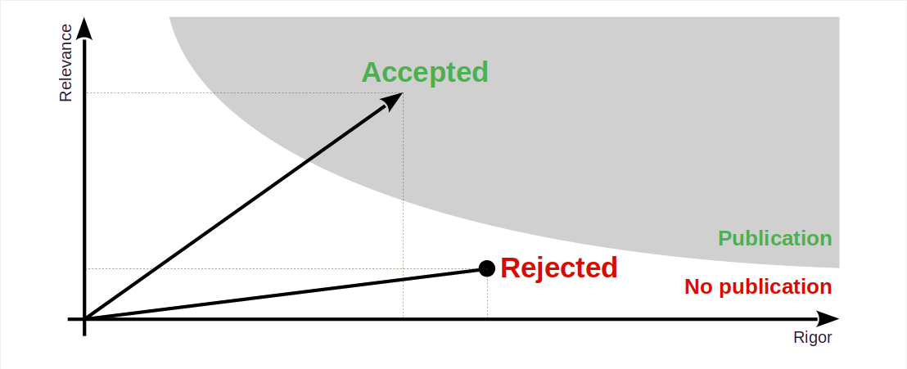
Rigor vs. Relevance

Slide 25
3. Science as a Social System

Slide 26
Scientific Communication
A research paper is
A (written) article published in an accredited publication outlet like
Academic journals
Conference proceedings
Special events / outlets
Other forms of scientific communication
Research grant proposals
Opinions, letters to the editor
Public and private peer reviews

Slide 27
Scientific Quality Assurance
A peer review is
The quality assessment of scientific communication by a peer
Where a peer is another scientist
A review process is
The overall quality assessment of some scientific writing
Based on (several) peer reviews and
Editorial / committee deliberation
The number of paper citations is
The count of other research papers referencing your work
A key metric in assessing impact (not necessarily quality)

Slide 28
Who Can be a Researcher / Scientist?
Everyone.
We are all peers.
Some are more peer than others.

Slide 29
4. Programs and Projects

Slide 30
Program and Project Hierarchy
Role | Level | Purpose
Sponsor | Theme | Defines a research theme Funds programs within the theme
Program manager | Program | Applies for managing a program If chosen, manages the program
Principal investigator | Projects | Applies for a project within a program If accepted, carries out the project

Slide 31
Example Parties
Role | Example
Sponsor | DFG, BMBF, BMWK, …
Program manager | DFG, DLR, VDI/VDE
Principal investigator | Any scientist

Slide 32
Example Theme, Program, and Projects
Level | Example
Theme | Innovation in software engineering
Program | Improving programmer productivity
Projects | How to use chat AIs for code generation? Is static typing superior to dynamic typing?

Slide 33
The Role of Students in Research Projects
Role | Responsibility
Principal investigator | Project / research agenda
Graduate researcher | Major component in project
Final thesis student | Contribution to major component

Slide 34
5. Science and Society

Slide 35
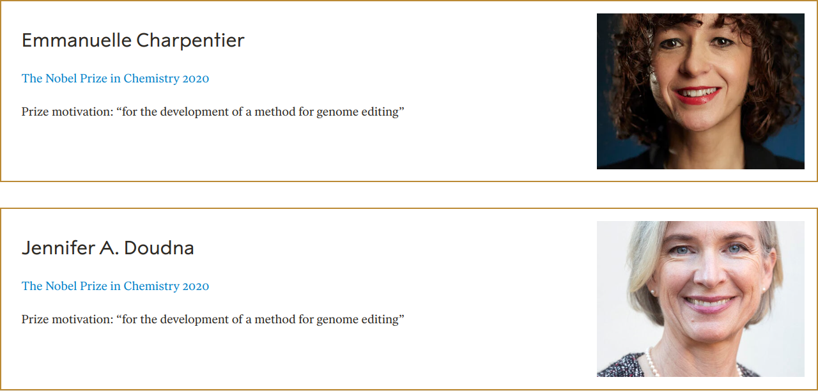
The Nobel Prize [1] in Chemistry (2020)
[1] See https://www.nobelprize.org/

Slide 36
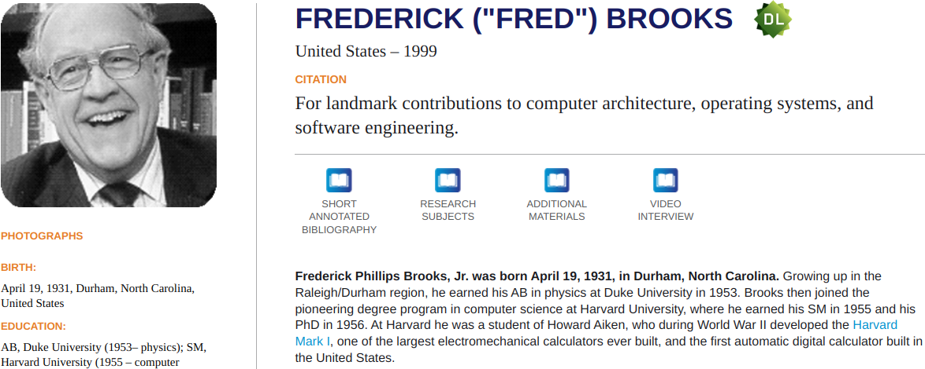
The ACM’s A.M. Turing Award [1] (1999)
[1] See https://amturing.acm.org/

Slide 37
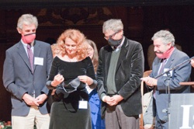
The 2009 Ig Nobel Prizes [1]
VETERINARY MEDICINE PRIZE: Catherine Douglas and Peter Rowlinson of Newcastle University, Newcastle-Upon-Tyne, UK, for showing that cows who have names give more milk than cows that are nameless. REFERENCE: “Exploring Stock Managers’ Perceptions of the Human-Animal Relationship on Dairy Farms and an Association with Milk Production,” Catherine Bertenshaw [Douglas] and Peter Rowlinson, Anthrozoos, vol. 22, no. 1, March 2009, pp. 59-69. DOI: 10.2752/175303708X390473.
PEACE PRIZE: Stephan Bolliger, Steffen Ross, Lars Oesterhelweg, Michael Thali and Beat Kneubuehl of the University of Bern, Switzerland, for determining — by experiment — whether it is better to be smashed over the head with a full bottle of beer or with an empty bottle. REFERENCE: “Are Full or Empty Beer Bottles Sturdier and Does Their Fracture-Threshold Suffice to Break the Human Skull?” Stephan A. Bolliger, Steffen Ross, Lars Oesterhelweg, Michael J. Thali and Beat P. Kneubuehl, Journal of Forensic and Legal Medicine, vol. 16, no. 3, April 2009, pp. 138-42. DOI:10.1016/j.jflm.2008.07.013.
PUBLIC HEALTH PRIZE: Elena N. Bodnar, Raphael C. Lee, and Sandra Marijan of Chicago, Illinois, USA, for inventing a brassiere that, in an emergency, can be quickly converted into a pair of protective face masks, one for the brassiere wearer and one to be given to some needy bystander. REFERENCE: U.S. patent # 7255627, granted August 14, 2007 for a “Garment Device Convertible to One or More Facemasks.”
[1] See https://improbable.com/

Slide 38
6. Research Ethics

Slide 39
Research, the Researcher, and Ethics
Your ethics as well as ethical standards provide criteria of what and what not to do
You are your own agent and cannot delegate (or hide from) responsibility

Slide 40
Escalation Levels of Responsibility
Party | Country | Program sponsor | Principal investigator | Individual researcher
Laws | x | x | x | x
Ethical standards |  | x | x | x
Project obligations |  |  | x | x
Personal value system |  |  |  | x

Slide 41
Ethical Conduct in Software Engineering Research [1]
Informed consent is given
When a participant received all relevant information and explicitly agreed to participate
Scientific value is given
When relative to other work the combined rigor and relevance outweighs the competition
Beneficence is given
When the expected gains far outweigh any harms that might result from the research
(Sufficient) confidentiality is given
When participants remain anonymous and data confidential to the extent possible
[1] See Singer & Vinson (2002): Ethical issues in empirical studies of software engineering.

Slide 42
DFG’s Safeguarding Good Scientific Practice [1]
Good scientific practice
Institutional rules
Organization
Young scientists
Impartial counselors
Performance evaluation
Data handling
Procedure for suspected misconduct
Cooperation of institutes
Learned societies
Authorship
Scientific journals
Guidelines for research proposals
Rules for the use of funds
Reviewers
Ombudsman for science
[1] See DFG (1998): Vorschläge zur Sicherung guter wissenschaftlicher Praxis.

Slide 43
MPG’s Rules for Safeguarding Scientific Practice [1]
General principles of scientific practice
Cooperation and leadership responsibility within working groups
Guidance to junior scientists
Securing and storing primary data
Data protection
Scientific publications
Conflicts of interest between science and industry
Appointing ombudspersons
Whistleblower protection
[1] See MPG (2009): Regeln zur Sicherung guter wissenschaftlicher Praxis.

Slide 44
Summary
What is science?
Theory building and validation
Science as a social system
Programs and projects
Science and society
Research ethics

Slide 45
Thank you! Any questions?
dirk.riehle@fau.de – https://oss.cs.fau.de
dirk@riehle.org – https://dirkriehle.com – @dirkriehle

Slide 46
Legal Notices
License
Licensed under the CC BY 4.0 International license
Copyright
© 2012, 2023, 2024 Dirk Riehle, some rights reserved

